Slide 1
Bildbasierte digitale Aufzeichnung realer Schachspiele
Aileen Jurkosek und Julian Hardtung

Slide 2
Inhalt
Grundlagen
Notationen
Hintergrund
Methodik
Umsetzung
Board Localization
Occupancy Classification
Piece Classification
Ergebnisse

Slide 3
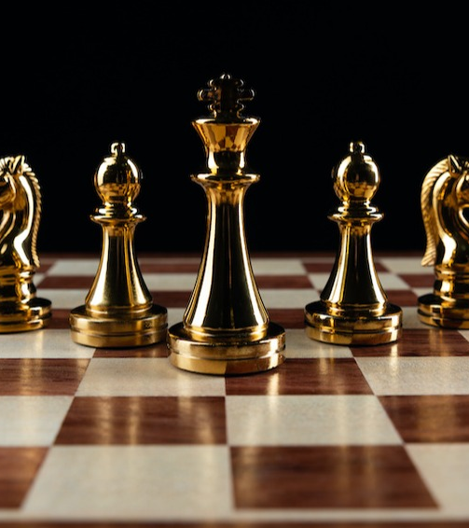
Grundlagen

Slide 4

Algebraic Chess Notation
RANK
8
7
6
5
4
3
2
1
a8 | b8 | c8 | d8 | e8 | f8 | g8 | h8
a7 | b7 | c7 | d7 | e7 | f7 | g7 | h7
a6 | b6 | c6 | d6 | e6 | f6 | g6 | h6
a5 | b5 | c5 | d5 | e5 | f5 | g5 | h5
a4 | b4 | c4 | d4 | e4 | f4 | g4 | h4
a3 | b3 | c3 | d3 | e3 | f3 | g3 | h3
a2 | b2 | c2 | d2 | e2 | f2 | g2 | h2
a1 | b1 | c1 | d1 | e1 | f1 | g1 | h1
King: K
Queen: Q
Rook: R
Bishop: B
Knight: N
Pawn: keine Abkürzung
F
I
L
E
a b c d e f g h

Slide 5
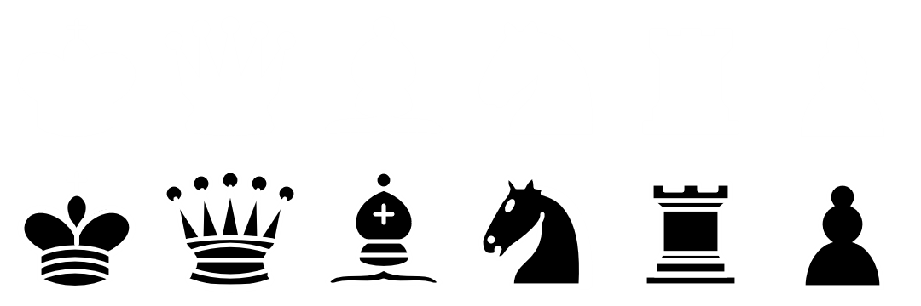
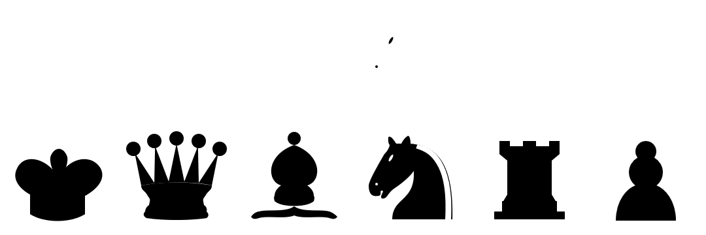
Forsyth–Edwards Notation (FEN)
RANK
8
7
6
5
4
3
2
1
r3r1k1
pp3nPp
1 b 1 p 1 B 2
1q1P1N2
8
P4Q2
1P3PK1
R6R
F
I
L
E
a b c d e f g h

Slide 6
Hintergrund
Durchführung eines physischen Schachspiels
Festhalten einzelner Spielpositionen mit Fotos
Eingabe der Positionen an einem Computer
→ Möglichkeit zur Analyse des Spiels
→ Automatisierung der Eingabe weniger aufwändig oder fehleranfällig

Slide 7
Methodik
Board Localization
Occupancy Classification
Piece Classification

Slide 8
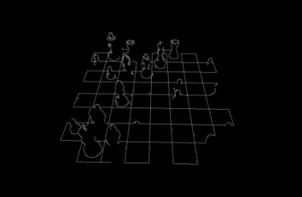
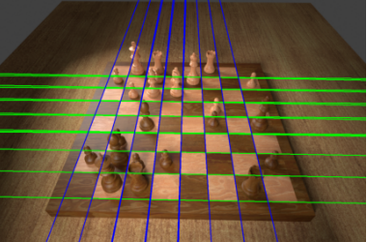
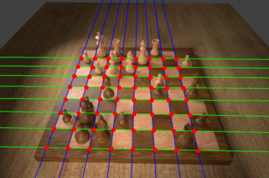
Board Localization - Theorie
Schachbrett soll digital erkannt werden
Finden der Schnittpunkte
Anwendung auf Grauwertbild
Durchführung möglich mit Canny Edge Detector, Hough Transformation und Clustern der gefundenen Punkte
Berechnung der Homografie
Warping des Eingabebildes
Durchführung einer projektiven Transformation

Slide 9
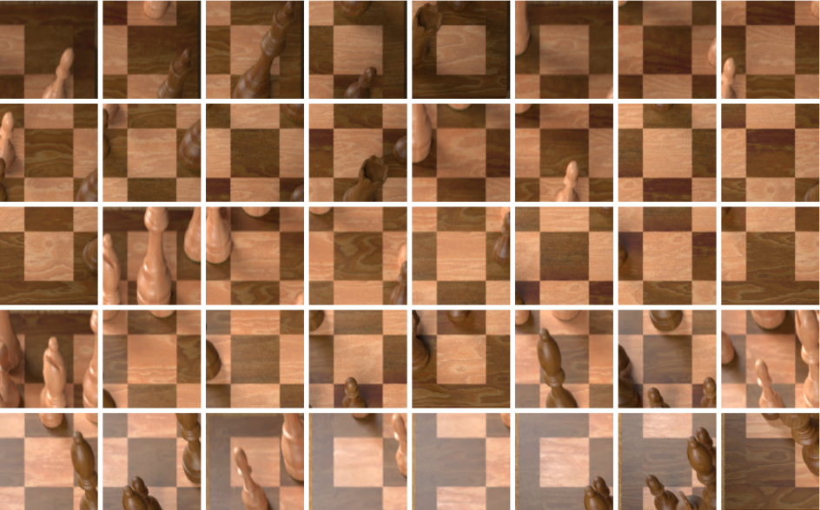
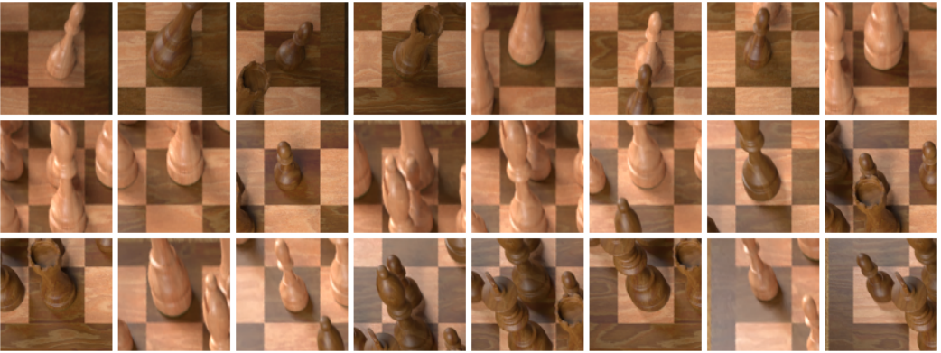
Occupancy Classification - Theorie
Erkennung, ob Felder des Schachbrettes belegt oder frei sind
Training von CNNs mit verschiedenen Input Bildern und verschiedenen Parametern
Modelle liefern Output Units welche die Klassen Leer und Belegt repräsentieren

Slide 10
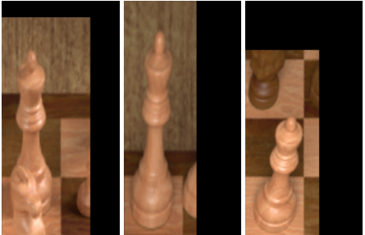
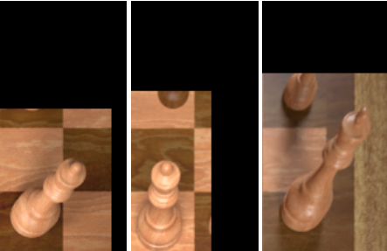
Piece Classification - Theorie
Erkennung der verschiedenen Figuren
Bauer, Läufer, Springer, Turm, Dame, König
Je weiß oder schwarz
Bildausschnitt wird als Eingabe gegeben
Ausgabe liefert Schachfigur auf dem entsprechenden Feld
Erweiterung der Bounding Boxes zur Vermeidung abgeschnittener Figuren

Slide 11
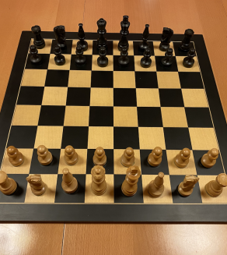
Umsetzung

Slide 12
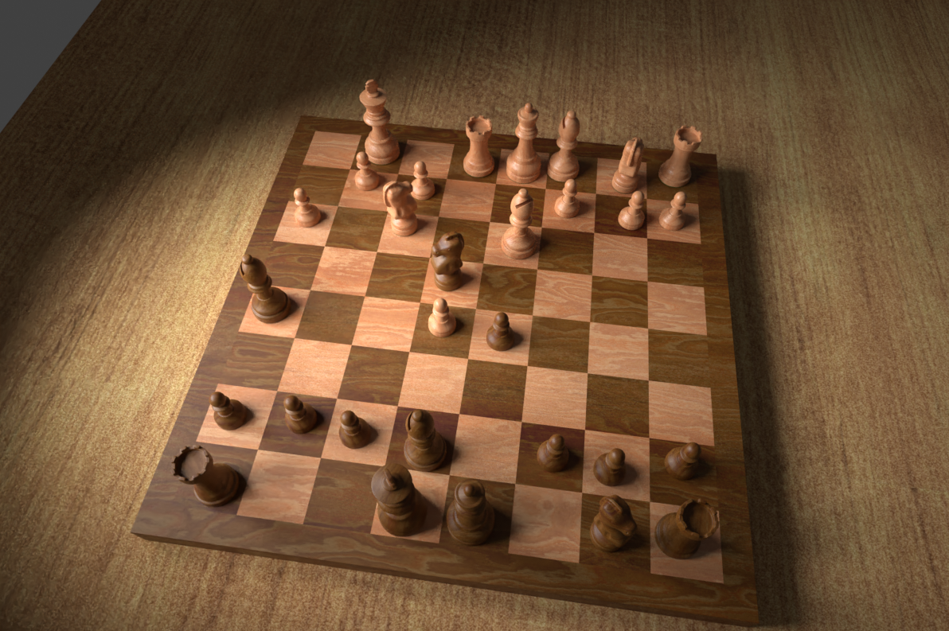
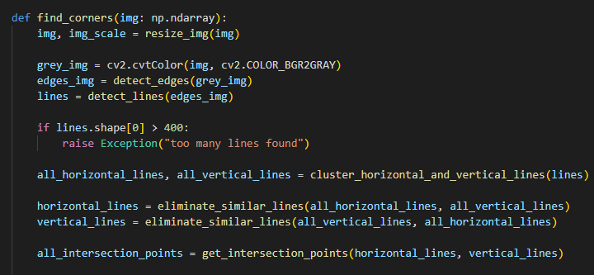
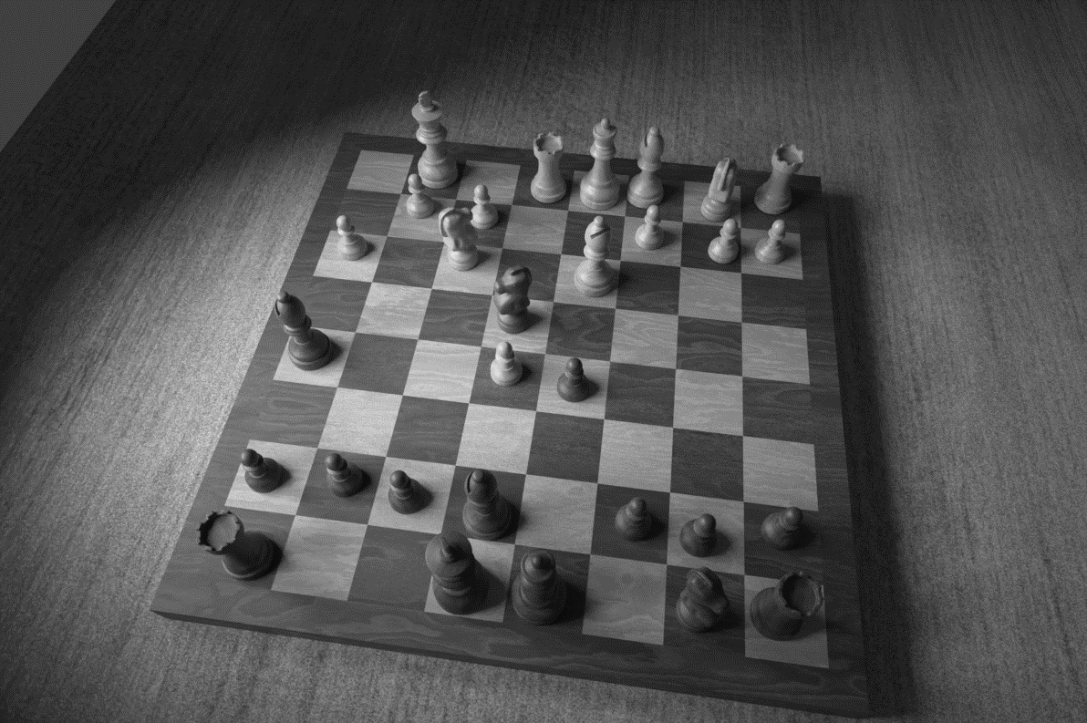
1. Board Localization
Konvertierung in Grauwertbild
Finden der Ecken und Linien im Bild

Slide 13
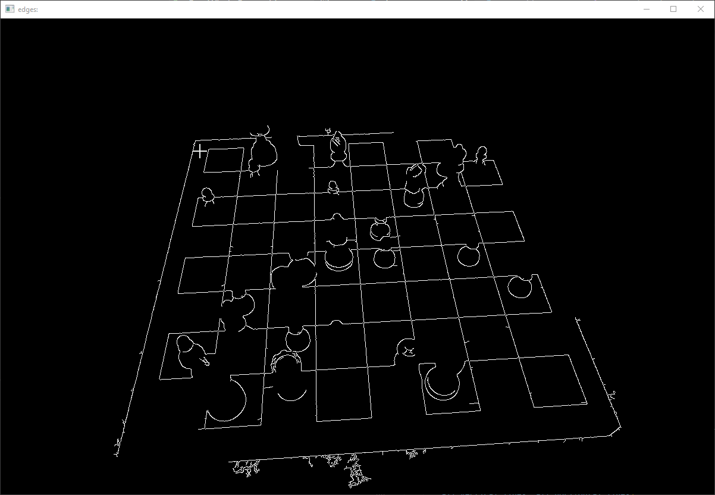
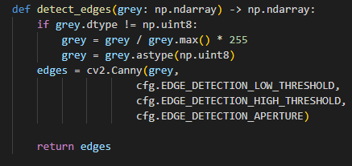
1. Board Localization
Ecken finden mit Canny-Edge-Detector

Slide 14
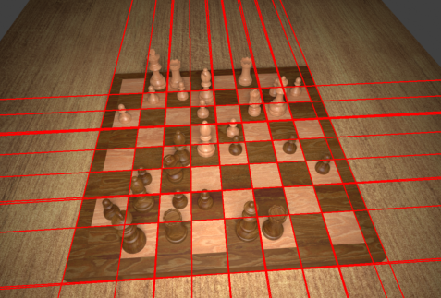
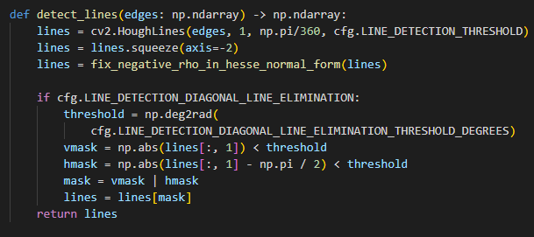
1. Board Localization
Linien finden mit Hough-Transformation

Slide 15
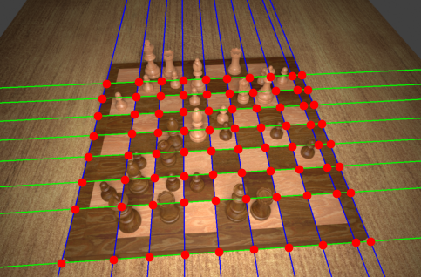
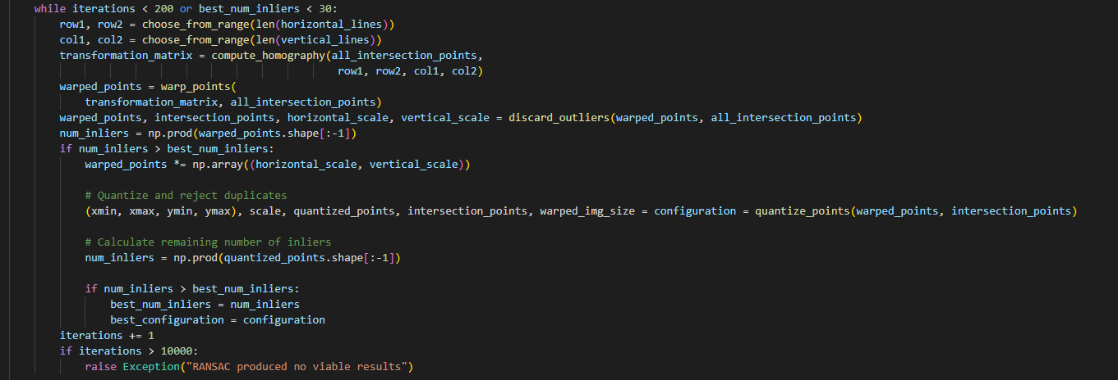
1. Board Localization
Clustern der horizontalen und vertikalen Linien
Berechnung der Schnittpunkte
Berechnung der Homografie-Matrix über RANSAC-Algorithmus

Slide 16
1. Board Localization
Berechnung der Homografie-Matrix über RANSAC-Algorithmus
Wiederholung, bis festgelegter Schwellenwert erreicht ist

Slide 17
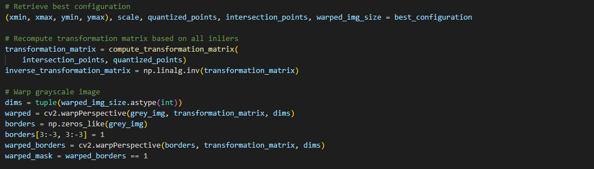
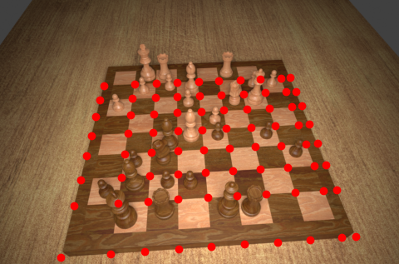
1. Board Localization
Berechnung der Homografie
Perspektive des Bildes/der Koordinaten korrigieren

Slide 18
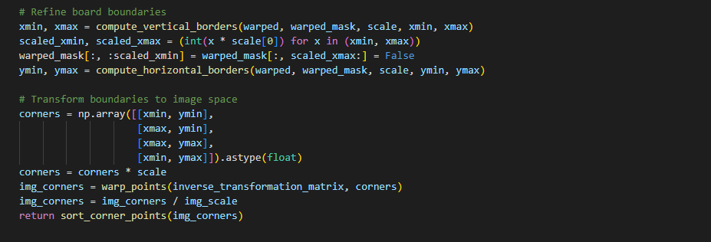

1. Board Localization
Vertikale und horizontale Grenzen finden
4 Eckpunkte des Schachbretts ausgeben

Slide 19
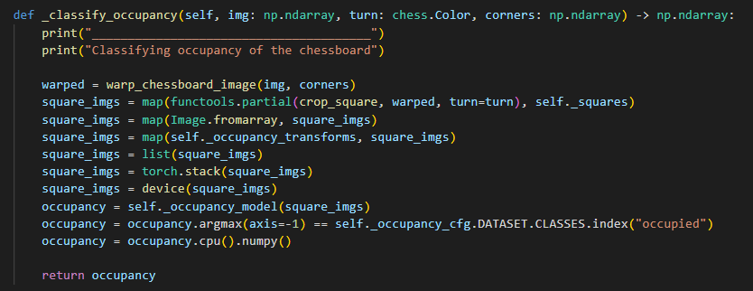
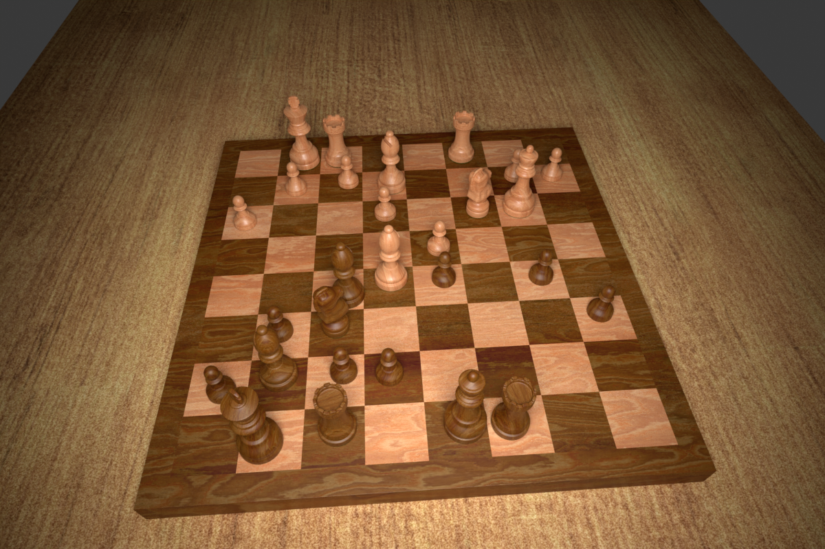
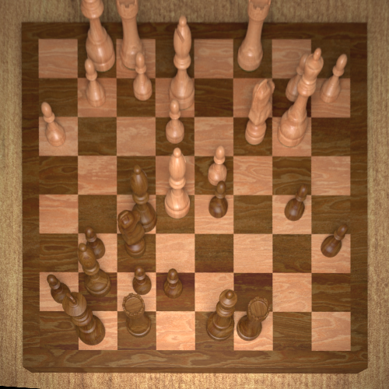
2. Occupancy Classification
Verzerren des Bildes basierend auf den gefundenen Eckpunkten des Schachbrettes
Notes:
Occupancy classification
Problem while performing Piece classification directly after Corner detection: large number of false positives (for example empty squares are classified as containing a piece)
Solution:
Training a binary classifier to decide if a square is empty or not
Use of six vanilla CNN architectures – two accept 100 x 100 pixel input images, four accept 50 x 50 input images
Differ in number of convolutional layers, pooling layers and fully connected layers
Models are referred to through a 4-tupel consisting of the input side length and the three layers
Final connected layer in a model contains two output units that represent the two classes “occupied” and “empty”
Further training with Adam Optimizer
Deeper models are fine tuned by pre-training them on the ImageNet dataset
Final layer of each pre-trained models classification head is replaced with a fully-connected layer that has two output units to classify empty or occupied squares

Slide 20
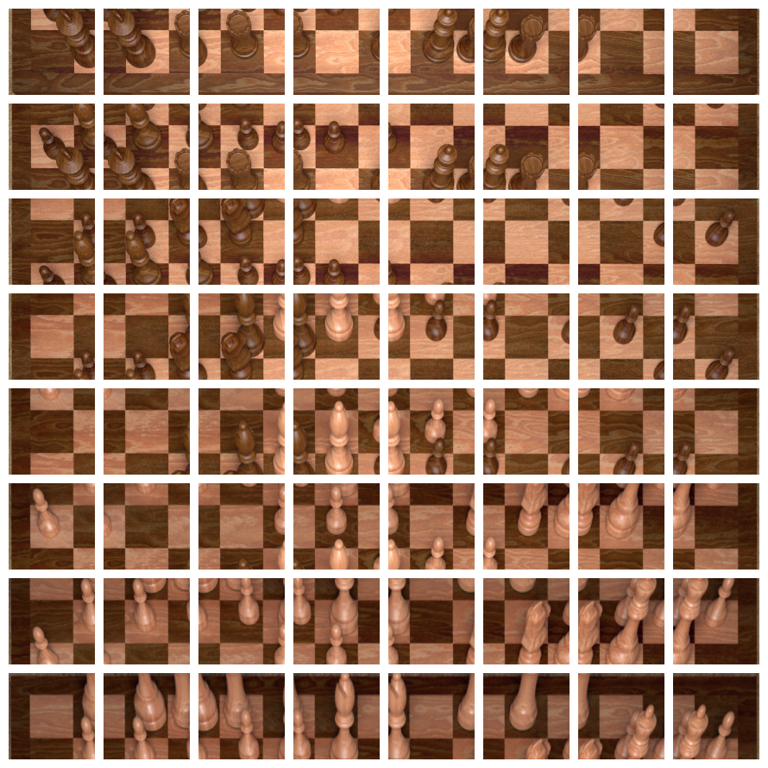
2. Occupancy Classification
Ausschneiden der einzelnen Felder des entzerrten Schachbrettes
Mit zusätzlichem Rand
Notes:
Occupancy classification
Problem while performing Piece classification directly after Corner detection: large number of false positives (for example empty squares are classified as containing a piece)
Solution:
Training a binary classifier to decide if a square is empty or not
Use of six vanilla CNN architectures – two accept 100 x 100 pixel input images, four accept 50 x 50 input images
Differ in number of convolutional layers, pooling layers and fully connected layers
Models are referred to through a 4-tupel consisting of the input side length and the three layers
Final connected layer in a model contains two output units that represent the two classes “occupied” and “empty”
Further training with Adam Optimizer
Deeper models are fine tuned by pre-training them on the ImageNet dataset
Final layer of each pre-trained models classification head is replaced with a fully-connected layer that has two output units to classify empty or occupied squares

Slide 21
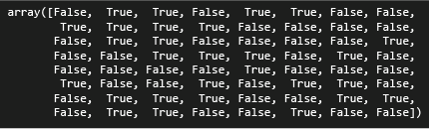
2. Occupancy Classification
Klassifizieren der Occupancy für jedes ausgeschnittene Feld
Notes:
Occupancy classification
Problem while performing Piece classification directly after Corner detection: large number of false positives (for example empty squares are classified as containing a piece)
Solution:
Training a binary classifier to decide if a square is empty or not
Use of six vanilla CNN architectures – two accept 100 x 100 pixel input images, four accept 50 x 50 input images
Differ in number of convolutional layers, pooling layers and fully connected layers
Models are referred to through a 4-tupel consisting of the input side length and the three layers
Final connected layer in a model contains two output units that represent the two classes “occupied” and “empty”
Further training with Adam Optimizer
Deeper models are fine tuned by pre-training them on the ImageNet dataset
Final layer of each pre-trained models classification head is replaced with a fully-connected layer that has two output units to classify empty or occupied squares

Slide 22
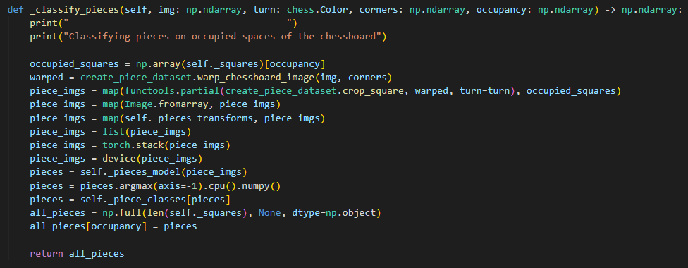
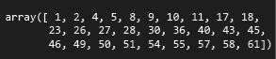
3. Piece Classification
Finde alle Felder mit Figuren
Notes:
Occupancy classification
Problem while performing Piece classification directly after Corner detection: large number of false positives (for example empty squares are classified as containing a piece)
Solution:
Training a binary classifier to decide if a square is empty or not
Use of six vanilla CNN architectures – two accept 100 x 100 pixel input images, four accept 50 x 50 input images
Differ in number of convolutional layers, pooling layers and fully connected layers
Models are referred to through a 4-tupel consisting of the input side length and the three layers
Final connected layer in a model contains two output units that represent the two classes “occupied” and “empty”
Further training with Adam Optimizer
Deeper models are fine tuned by pre-training them on the ImageNet dataset
Final layer of each pre-trained models classification head is replaced with a fully-connected layer that has two output units to classify empty or occupied squares

Slide 23
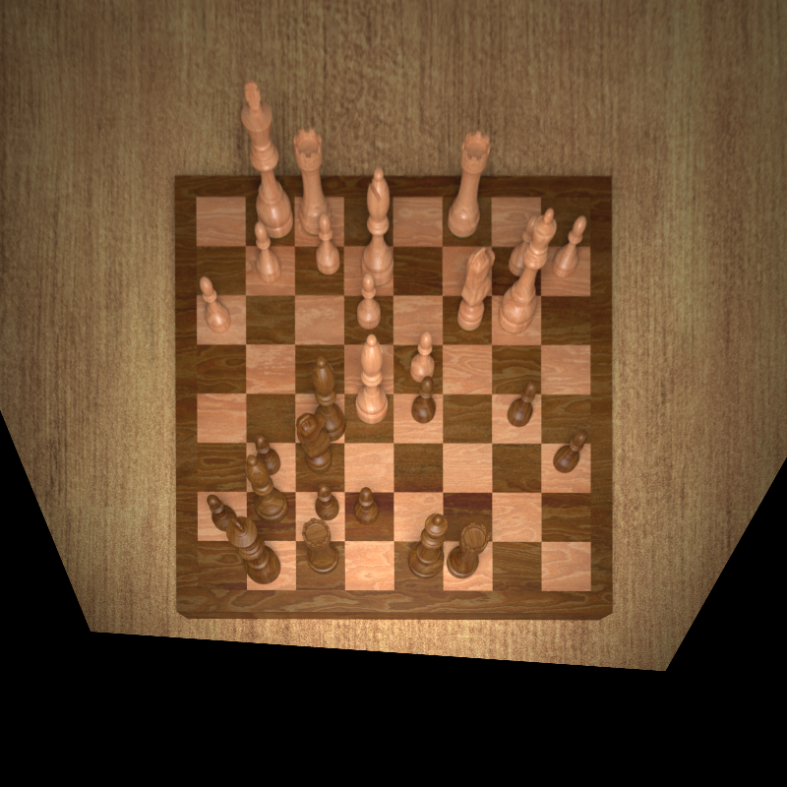
3. Piece Classification
Entzerre die einzelnen Bilder der Figuren
Notes:
Occupancy classification
Problem while performing Piece classification directly after Corner detection: large number of false positives (for example empty squares are classified as containing a piece)
Solution:
Training a binary classifier to decide if a square is empty or not
Use of six vanilla CNN architectures – two accept 100 x 100 pixel input images, four accept 50 x 50 input images
Differ in number of convolutional layers, pooling layers and fully connected layers
Models are referred to through a 4-tupel consisting of the input side length and the three layers
Final connected layer in a model contains two output units that represent the two classes “occupied” and “empty”
Further training with Adam Optimizer
Deeper models are fine tuned by pre-training them on the ImageNet dataset
Final layer of each pre-trained models classification head is replaced with a fully-connected layer that has two output units to classify empty or occupied squares

Slide 24
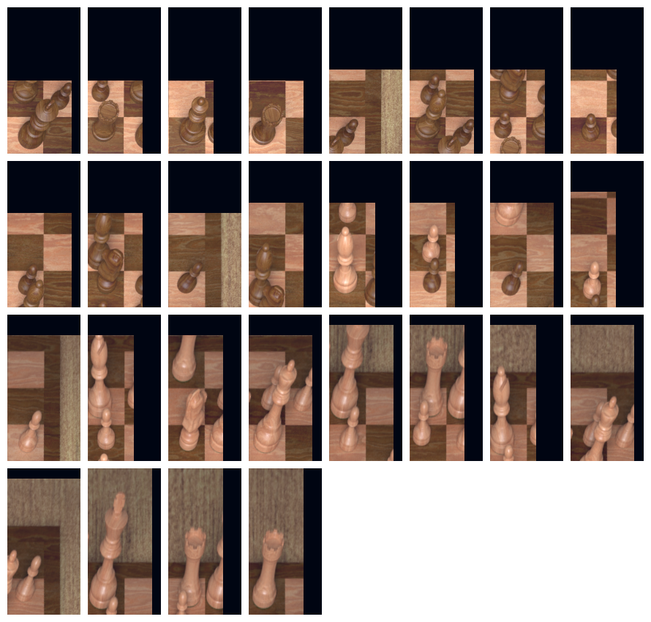
3. Piece Classification
Ausschneiden der einzelnen Felder des entzerrten Schachbrettes
Mit zusätzlichem Rand
Notes:
Occupancy classification
Problem while performing Piece classification directly after Corner detection: large number of false positives (for example empty squares are classified as containing a piece)
Solution:
Training a binary classifier to decide if a square is empty or not
Use of six vanilla CNN architectures – two accept 100 x 100 pixel input images, four accept 50 x 50 input images
Differ in number of convolutional layers, pooling layers and fully connected layers
Models are referred to through a 4-tupel consisting of the input side length and the three layers
Final connected layer in a model contains two output units that represent the two classes “occupied” and “empty”
Further training with Adam Optimizer
Deeper models are fine tuned by pre-training them on the ImageNet dataset
Final layer of each pre-trained models classification head is replaced with a fully-connected layer that has two output units to classify empty or occupied squares

Slide 25
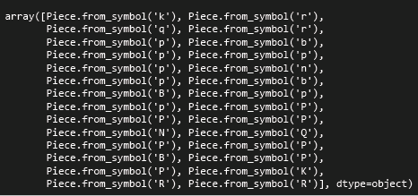
3. Piece Classification
Identifiziere die Spielfiguren mit dem trainierten CNN
Notes:
Occupancy classification
Problem while performing Piece classification directly after Corner detection: large number of false positives (for example empty squares are classified as containing a piece)
Solution:
Training a binary classifier to decide if a square is empty or not
Use of six vanilla CNN architectures – two accept 100 x 100 pixel input images, four accept 50 x 50 input images
Differ in number of convolutional layers, pooling layers and fully connected layers
Models are referred to through a 4-tupel consisting of the input side length and the three layers
Final connected layer in a model contains two output units that represent the two classes “occupied” and “empty”
Further training with Adam Optimizer
Deeper models are fine tuned by pre-training them on the ImageNet dataset
Final layer of each pre-trained models classification head is replaced with a fully-connected layer that has two output units to classify empty or occupied squares

Slide 26
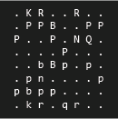
3. Piece Classification
Kombiniere die leeren Felder mit den vorher identifizierten Feldern und gib sie zurück
Notes:
Occupancy classification
Problem while performing Piece classification directly after Corner detection: large number of false positives (for example empty squares are classified as containing a piece)
Solution:
Training a binary classifier to decide if a square is empty or not
Use of six vanilla CNN architectures – two accept 100 x 100 pixel input images, four accept 50 x 50 input images
Differ in number of convolutional layers, pooling layers and fully connected layers
Models are referred to through a 4-tupel consisting of the input side length and the three layers
Final connected layer in a model contains two output units that represent the two classes “occupied” and “empty”
Further training with Adam Optimizer
Deeper models are fine tuned by pre-training them on the ImageNet dataset
Final layer of each pre-trained models classification head is replaced with a fully-connected layer that has two output units to classify empty or occupied squares

Slide 27
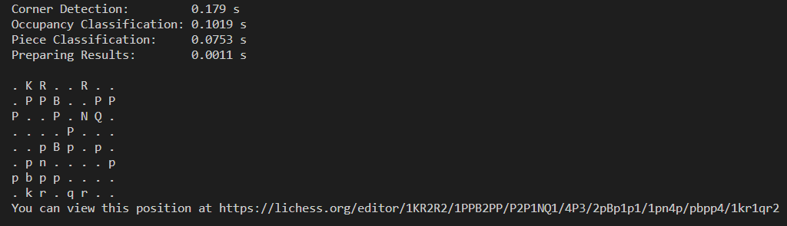
Ergebnisse
https://lichess.org/editor/1KR2R2/1PPB2PP/P2P1NQ1/4P3/2pBp1p1/1pn4p/pbpp4/1kr1qr2
Notes:
Occupancy classification
Problem while performing Piece classification directly after Corner detection: large number of false positives (for example empty squares are classified as containing a piece)
Solution:
Training a binary classifier to decide if a square is empty or not
Use of six vanilla CNN architectures – two accept 100 x 100 pixel input images, four accept 50 x 50 input images
Differ in number of convolutional layers, pooling layers and fully connected layers
Models are referred to through a 4-tupel consisting of the input side length and the three layers
Final connected layer in a model contains two output units that represent the two classes “occupied” and “empty”
Further training with Adam Optimizer
Deeper models are fine tuned by pre-training them on the ImageNet dataset
Final layer of each pre-trained models classification head is replaced with a fully-connected layer that has two output units to classify empty or occupied squares

Slide 28
Aussicht
Aktuelle Probleme / Limitierungen:
Jeder Spielzug muss bisher einzeln fotografiert und durch das System identifiziert werden
Bei jeder Identifikation muss die Farbe angegeben werden, aus welcher Sicht das Bild aufgenommen wurde
Jede identifizierte Schachposition steht für sich und kann aktuell nicht (automatisch) zu einem kompletten Schachspiel kombiniert werden
Notes:
Occupancy classification
Problem while performing Piece classification directly after Corner detection: large number of false positives (for example empty squares are classified as containing a piece)
Solution:
Training a binary classifier to decide if a square is empty or not
Use of six vanilla CNN architectures – two accept 100 x 100 pixel input images, four accept 50 x 50 input images
Differ in number of convolutional layers, pooling layers and fully connected layers
Models are referred to through a 4-tupel consisting of the input side length and the three layers
Final connected layer in a model contains two output units that represent the two classes “occupied” and “empty”
Further training with Adam Optimizer
Deeper models are fine tuned by pre-training them on the ImageNet dataset
Final layer of each pre-trained models classification head is replaced with a fully-connected layer that has two output units to classify empty or occupied squares

